Slide 1
Emit Calls Used in PL0
System Software
Spring 2013

Slide 2
Project Overview
Compiler Front End
Scanner (assignment 2): Reads the source code written by users and creates tokens. The scanner should find syntax errors in the code.
Compiler Mid Section
Parser and code generator(assignment 3): Parses the tokens, creates a symbol table and emits intermediate code.
Compiler Back End:
Virtual Machine (assignment 1): Reads the intermediate code and runs the program to completion.

Slide 3
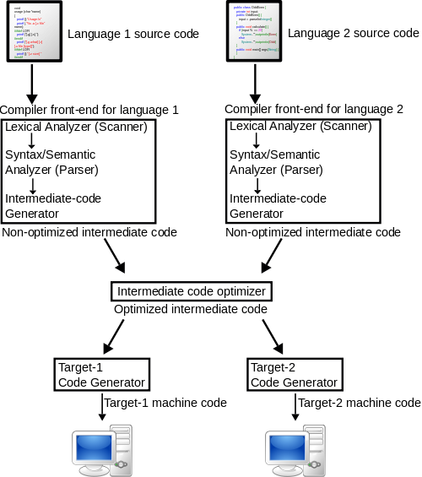
Project Overview cont.
Notes:
http://upload.wikimedia.org/wikipedia/commons/thumb/6/6b/Compiler.svg/500px-Compiler.svg.png

Slide 4
Emit/Gen
gen(x,y,z)
int x,y,z;
{
if (cx>cxmax) printf("program too long\n"); else
{
code[cx].f=x;
code[cx].l=y;
code[cx].a=z;
}
cx++;
}

Slide 5
Source code example of constant in block
Block{
…
do {
if (sym==constsym) {
getsym();
do {
constdeclaration(lev,&tx,&dx);
while(sym==comma) {
getsym(); constdeclaration(lev,&tx,&dx);
}
if(sym==semicolon)getsym(); else error(5);
} while (sym==ident);
}
…

Slide 6
Constant cont.
constdeclaration(lev,ptx,pdx)
int lev,*ptx,*pdx;
{
if (sym==ident) {
getsym();
if ((sym==eql) || (sym==becomes)) {
if (sym==becomes) error(1);
getsym();
if (sym==number) {enter(constant,ptx,pdx,lev); getsym();}
}
}
}

Slide 7
Constant
Constants are declared in the block of a program.
Constants can be used in an expression or any other place where a number could be used

Slide 8
Source code example of variable in block
Block{
…
do {
… //const code
if (sym==varsym) {
getsym();
do { vardeclaration(lev,&tx,&dx);
while (sym==comma) {
getsym(); vardeclaration(lev,&tx,&dx);
}
if(sym==semicolon) getsym(); else error(5);
} while(sym==ident);
}

Slide 9
Variable cont
vardeclaration(lev,ptx,pdx)
int *ptx,*pdx,lev;
{
if (sym==ident) {enter(variable, ptx,pdx,lev); getsym();}
else error(4);
}

Slide 10
Factor Emit example
Factor(lev, ptx)
int lev, *ptx;
{
int i, level, adr, val;
while ((sym==ident)||(sym==number)||(sym==lparen))
{
if (sym==ident)
{
i=position(id,ptx);
if (i==0) error(11); else
{
kind=table[i].kind;
level=table[i].level;
adr=table[i].adr;
val=table[i].val;
if (kind==constant) gen(lit,0,val);
else if (kind==variable) gen(lod,lev-level,adr);
else error(21);
}
getsym();

Slide 11
Factor example cont.
} else if(sym==number) {
if (num>amax) {error(31); num=0;}
gen(lit,0,num); getsym();
} else if(sym==lparen) {
getsym(); expression(lev,ptx);
if (sym==rparen)getsym(); else error(22);
}
}
}

Slide 12
Term Emit Example
term(lev,ptx)
int lev, *ptx;
{
int mulop;
factor(lev,ptx);
while((sym==mult)||(sym==slash)) {
mulop=sym; getsym(); factor(lev,ptx);
if (mulop==mult) gen(opr,0,4); else gen(opr,0,5);
}
}

